Slide 1
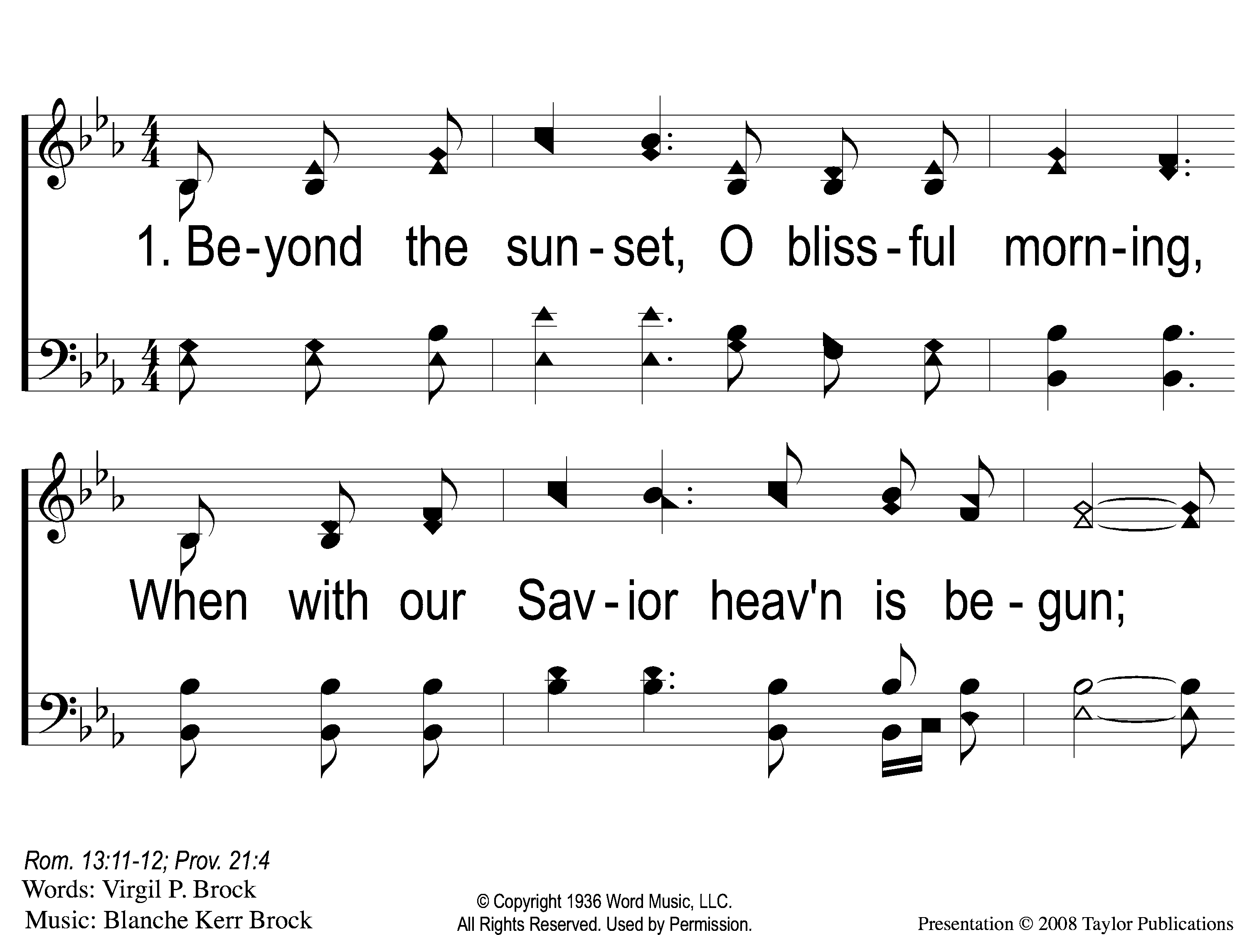
1-1 Beyond the Sunset
Beyond the Sunset
47

Slide 2
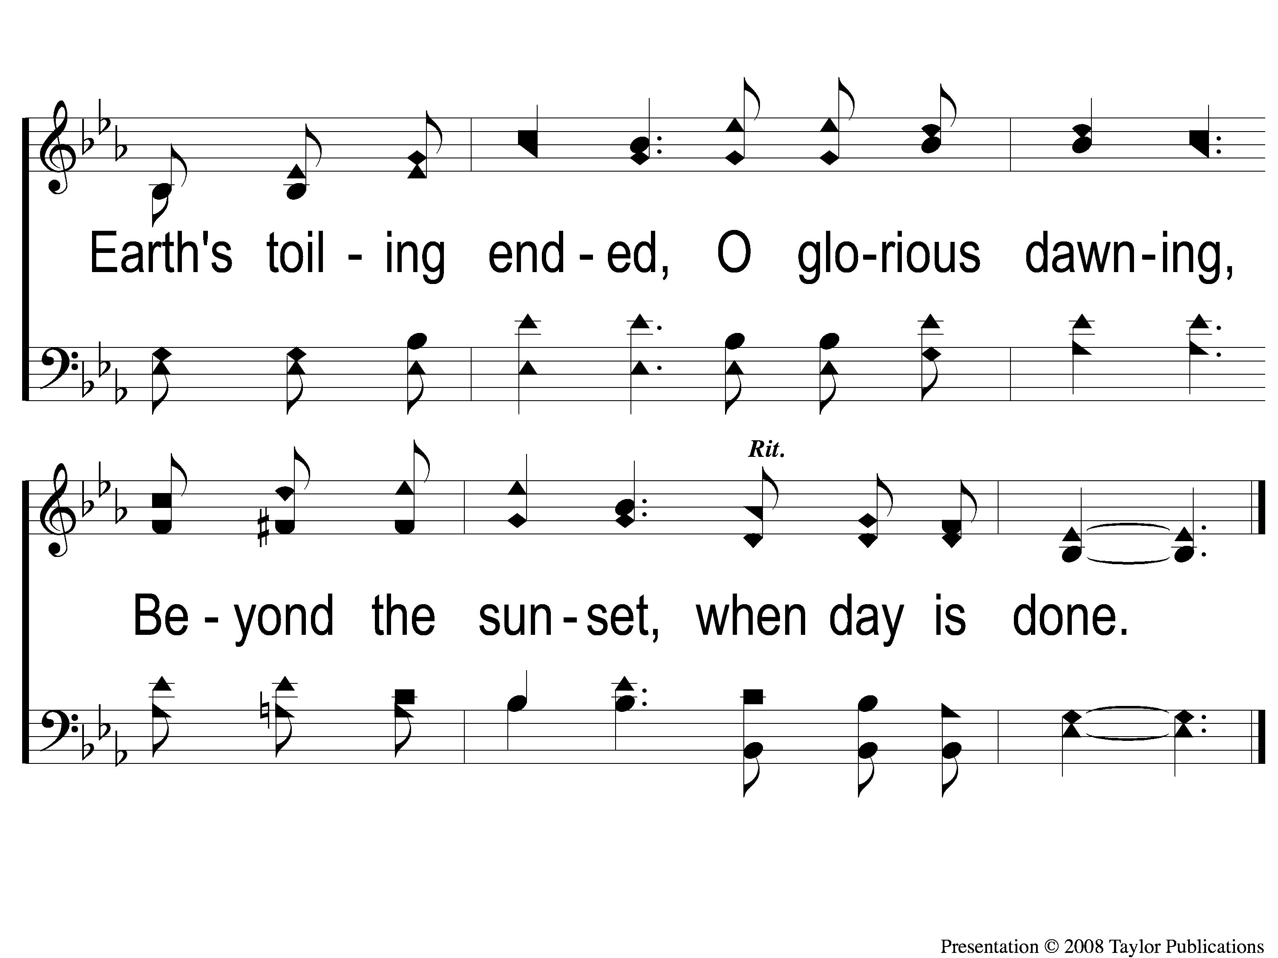
1-2 Beyond the Sunset
Beyond the Sunset
47

Slide 3
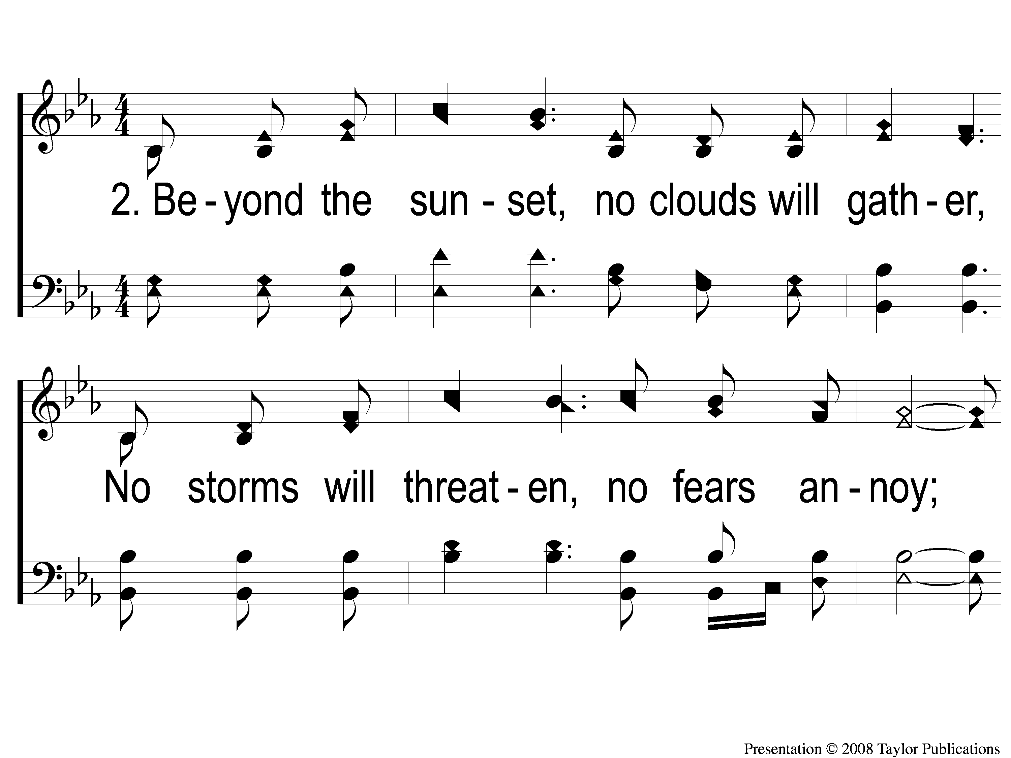
2-1 Beyond the Sunset
Beyond the Sunset
47

Slide 4
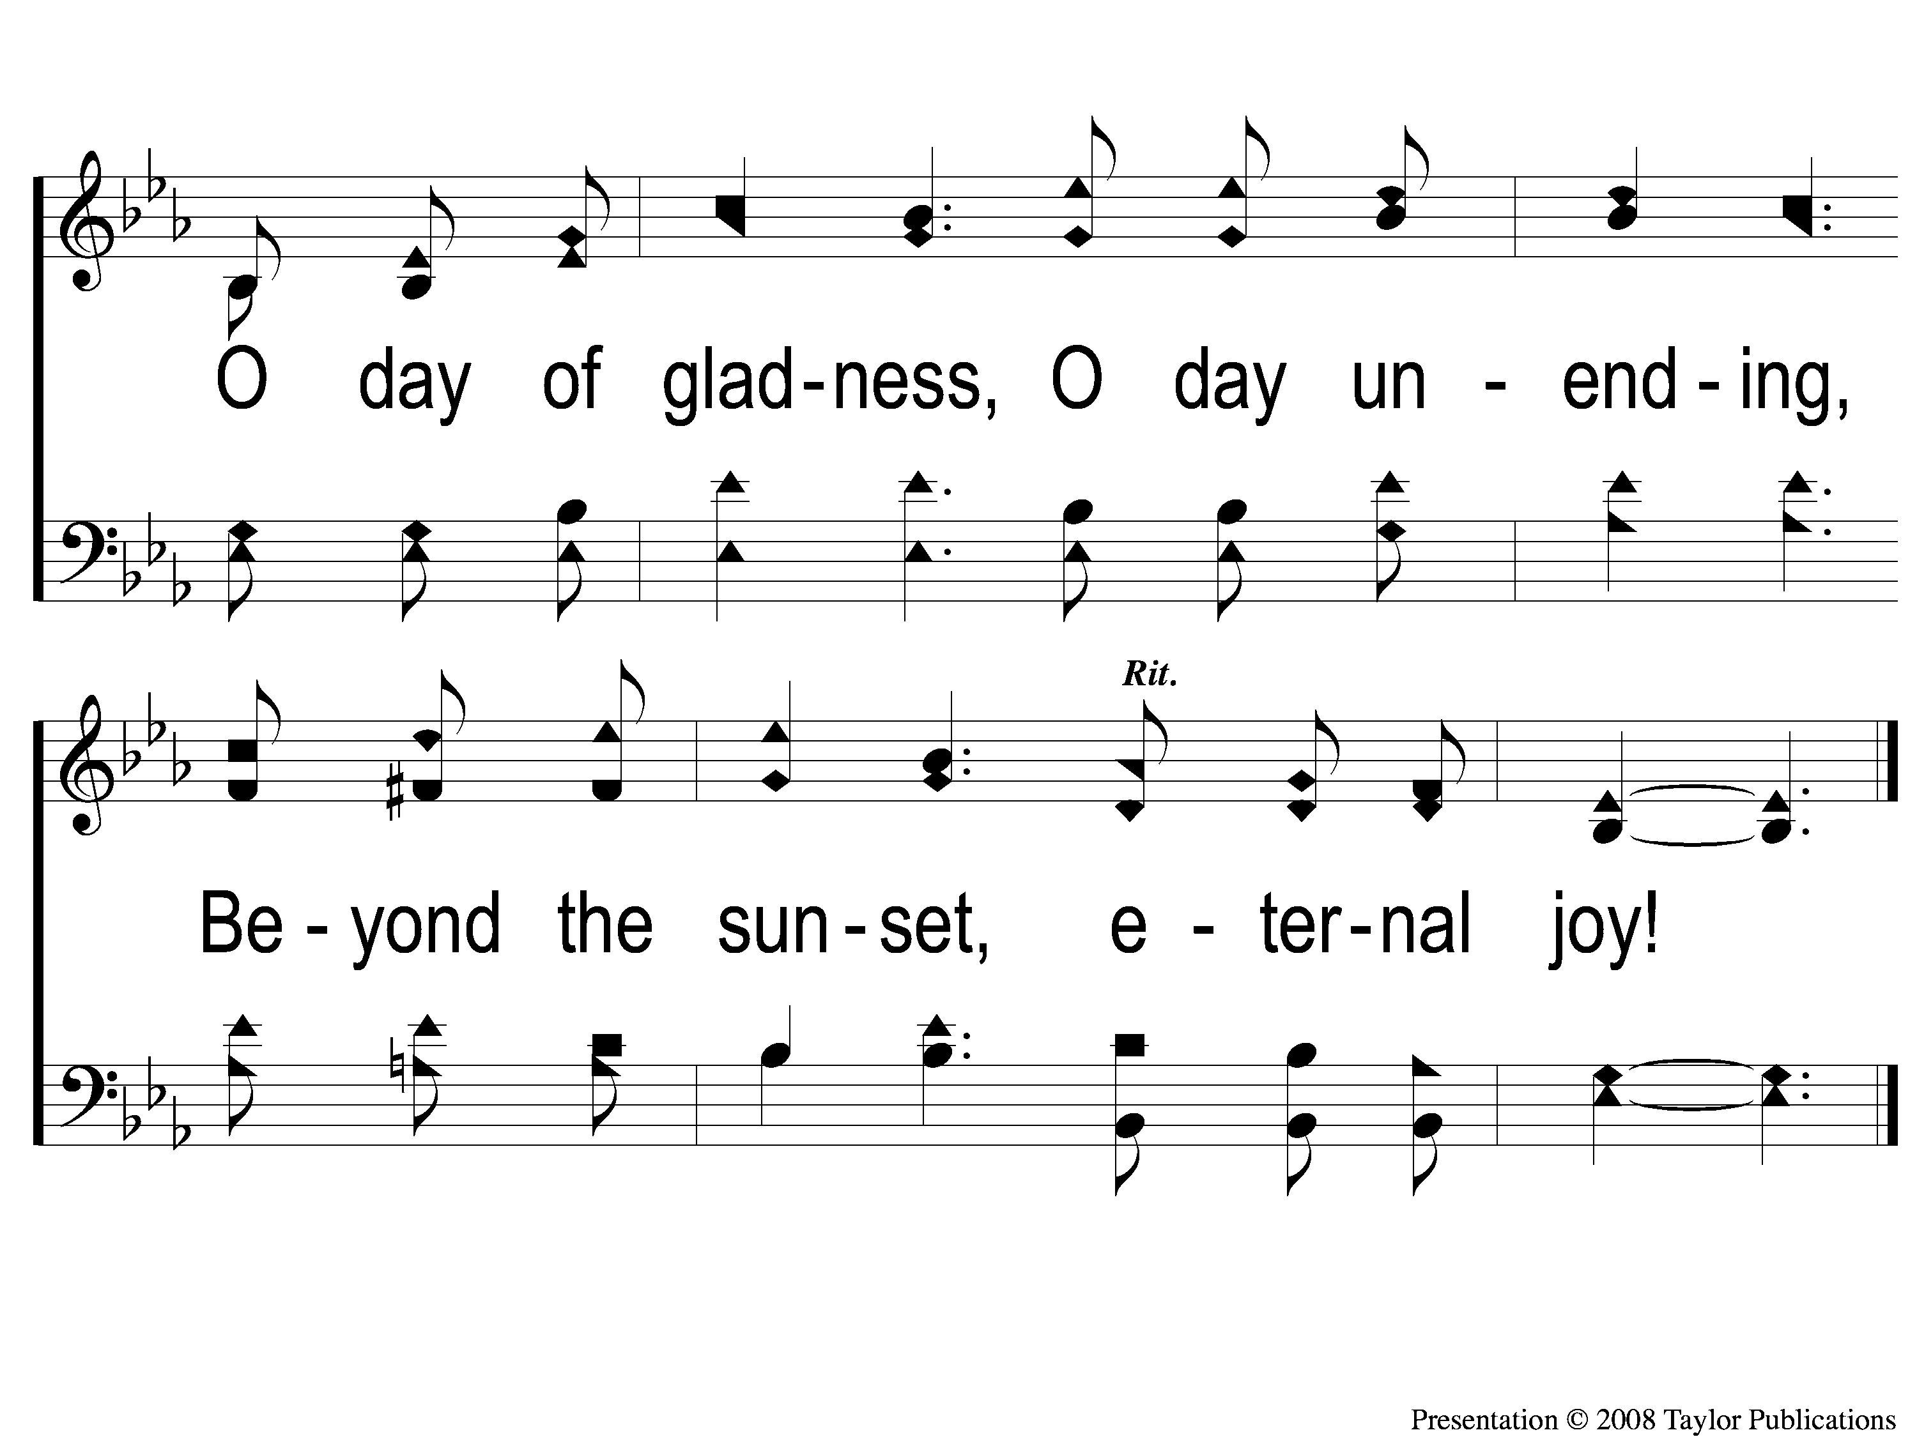
2-2 Beyond the Sunset
Beyond the Sunset
47

Slide 5
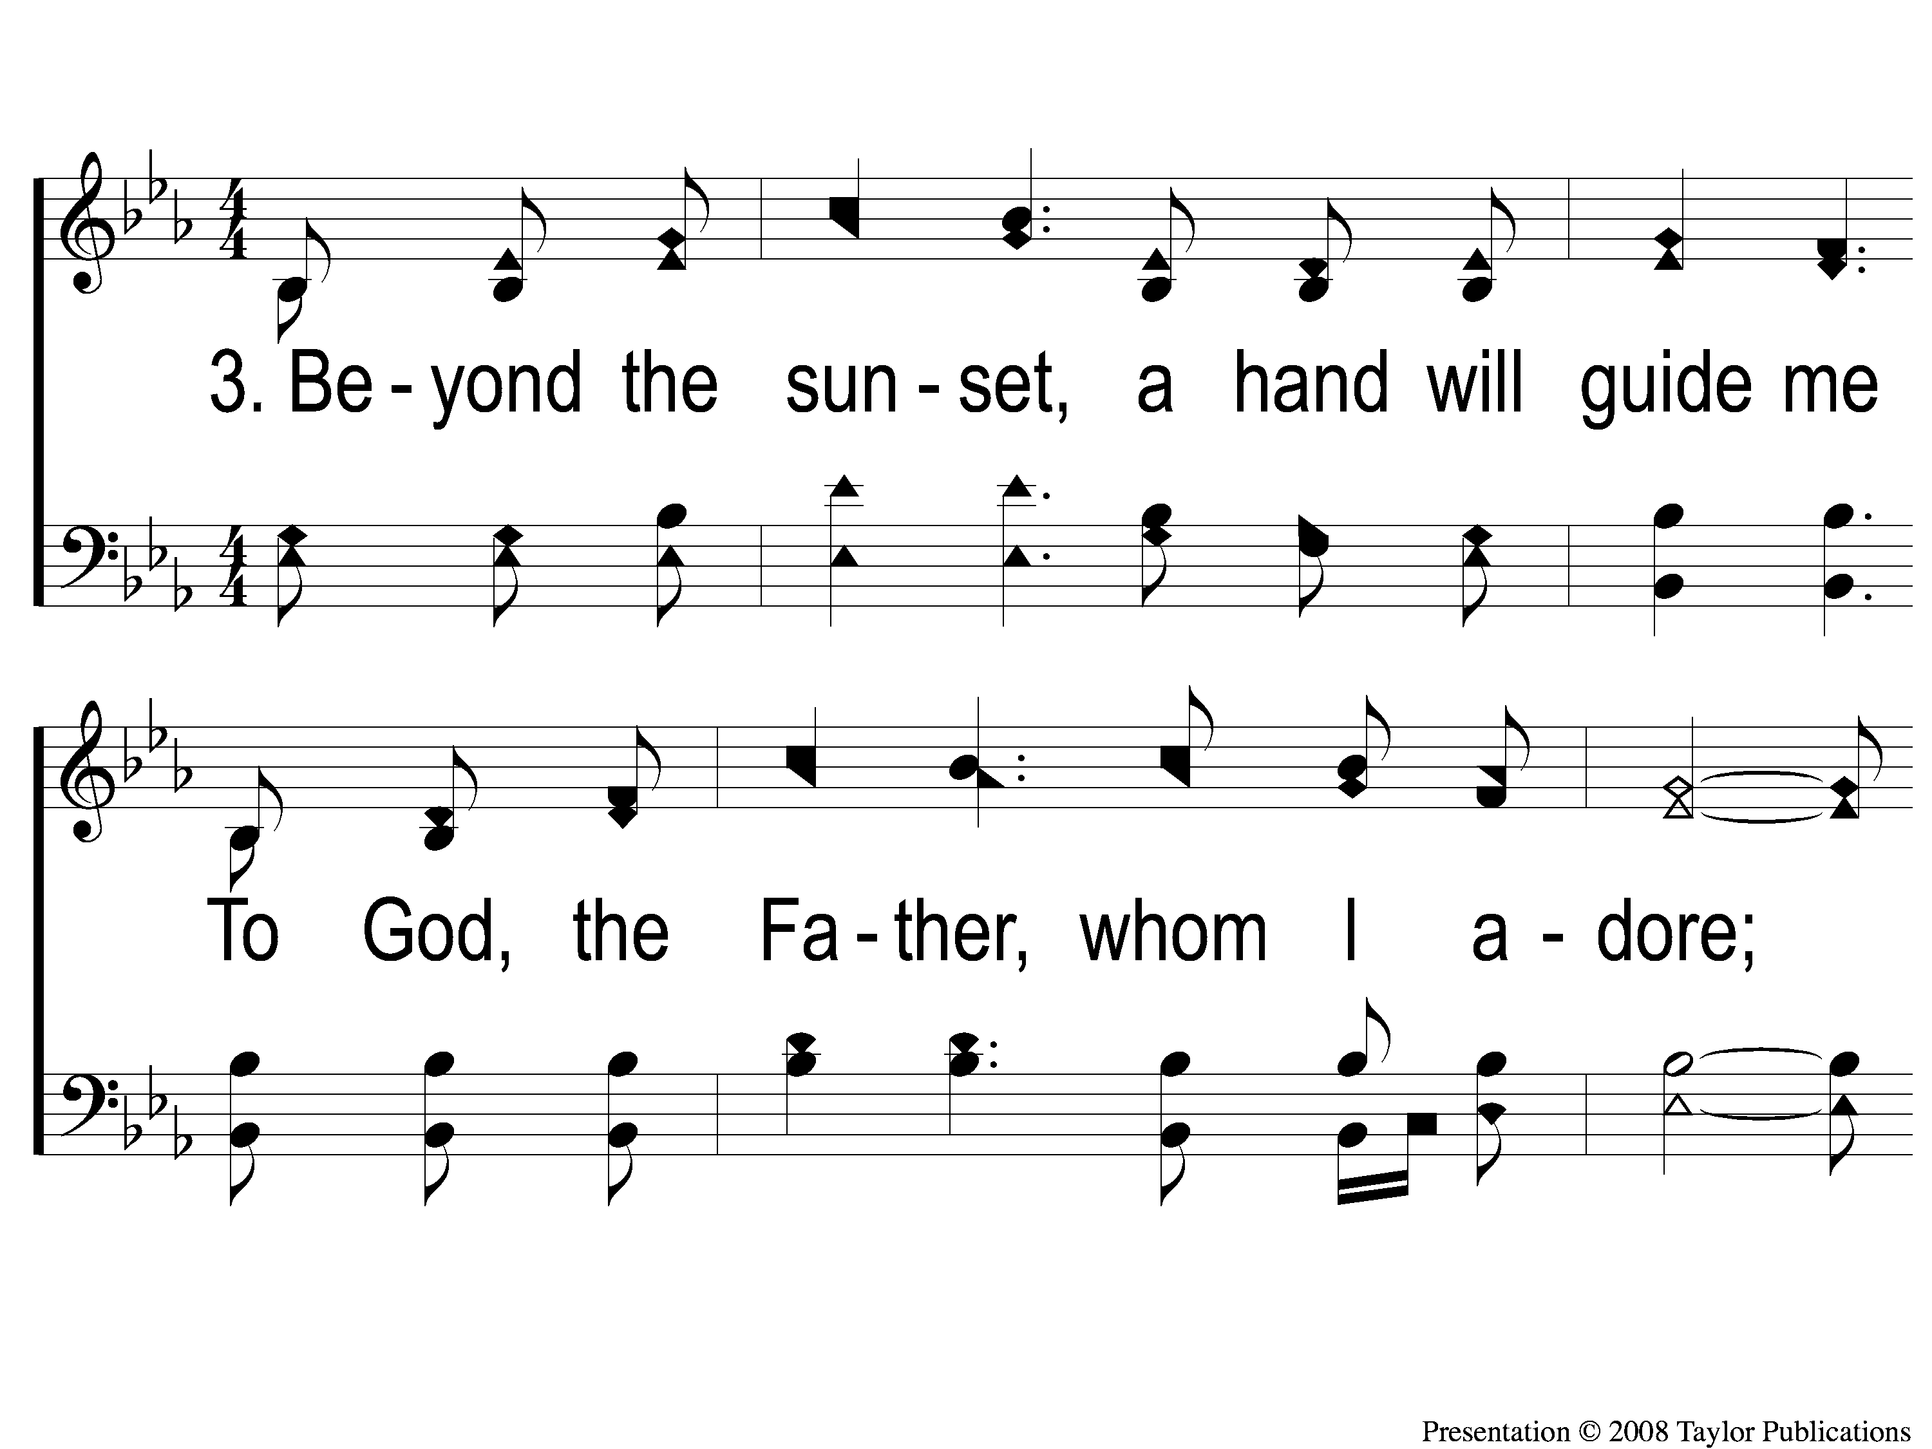
3-1 Beyond the Sunset
Beyond the Sunset
47

Slide 6
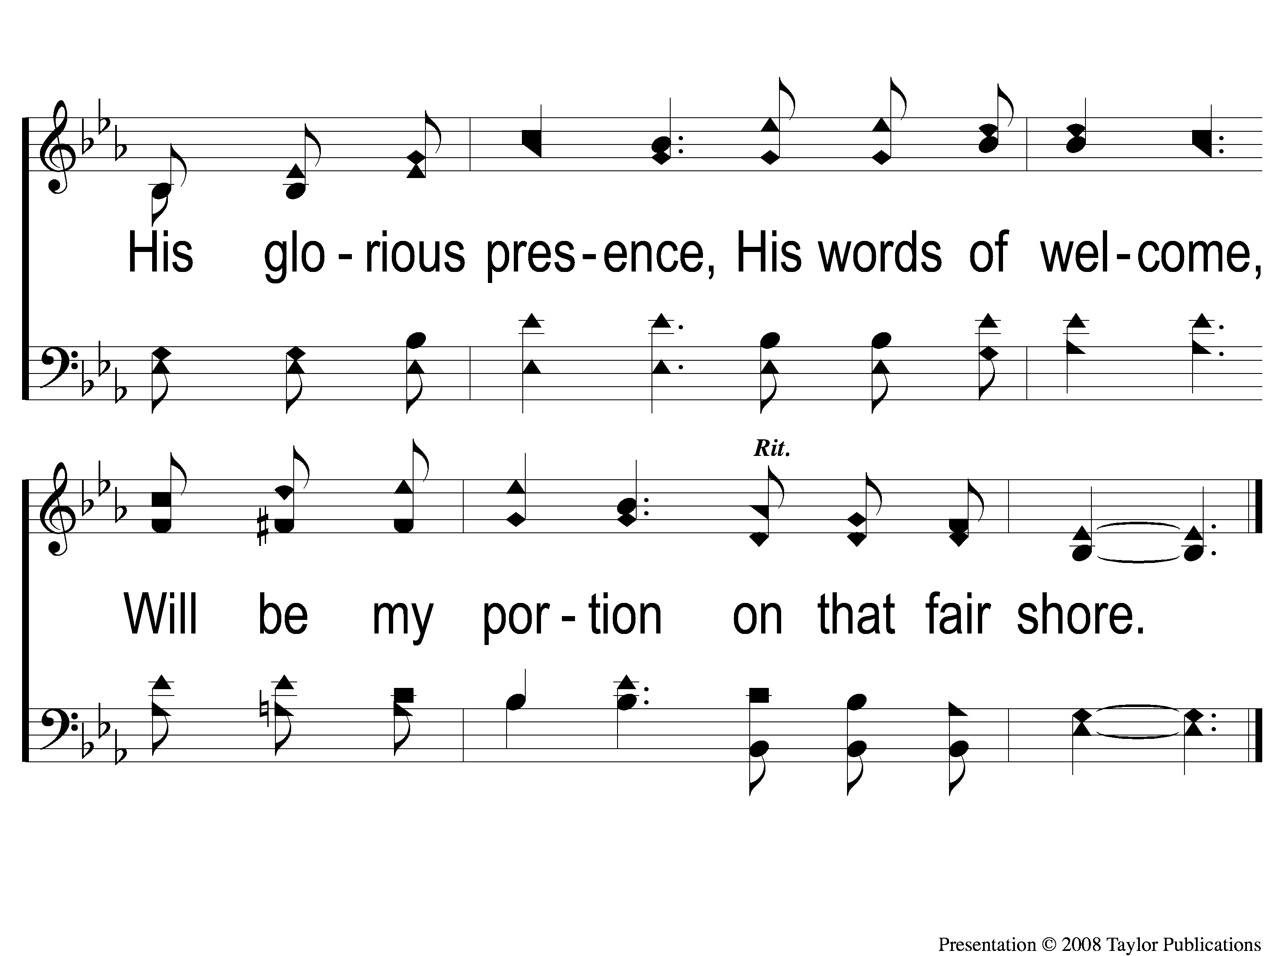
3-2 Beyond the Sunset
Beyond the Sunset
47

Slide 7
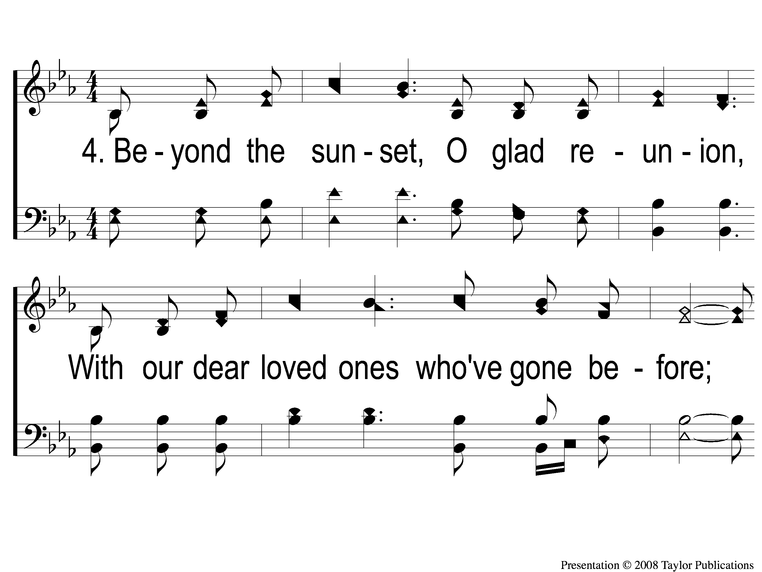
4-1 Beyond the Sunset
Beyond the Sunset
47

Slide 8

4-2 Beyond the Sunset
Beyond the Sunset
47

